Slide 1

Engaging Stakeholders with Insight
Mastek Engagement Accelerator
Please view in slide show mode

Slide 2

Mastek’s Banking Reference Architecture: Two Speed IT for Two Speed Business Operations
Enterprise Cloud
Partner Cloud
Public Cloud
Transaction Systems
Master Data Management
Data Warehouse
Third Party Information
Government
Information
Internet Of People
Internet Of Knowledge
Internet of Things
Document Management
Enterprise Rules Engine
Event Feeds
Customer Data
External Data
Social Feeds
Web Analytics
Sensor Feeds
Enterprise Service Bus
Mastek Engagement Accelerator
Request I Service I Value I Consume
Transaction Engine
Product Engine
Customer Relationship Engine
Analytics Engine
Customer Interaction Engine
Activity
Configuration
Loyalty
Insights
Engagement Tools
Short Transaction
BPM
T & C
Policies And Rules
Pricing
Relationship Metrics
Customer Persona
Transaction
Types
Data Sets
Visualisation
Account Registration, Payments, Loan approvals
Eligibility, Terms and Conditions, Features
Dynamic Interest Rates, Charges
Life Events, Moments Of Truth, Fraud, Trends
Personalised / Gamified UI
Internet
Branch Teller
ATM
Mobile Apps
Internet Banking
Internet Portal
Call centre

Slide 3
Engagement Accelerator Design
Sense
Process
Respond
Banking Action
Event Patterns
Response selector
Notification
Pass Through
Promotion
Alert
Investigate
Aggregate
Workflow
Greetings
Suggest
Social Feeds
Sequence
Processors
Workflow
Interesting attribute (Place, Value, Time )
Adapters
Device Information
Analytics
Rule Engine
Communication Engine
Campaign
Product
Fraud
Social – Life event, moment of truth
Other Systems updates
Site/App Behaviour
Transaction context
Life event context
Site/App behaviour
Customer context

Slide 4
Open API
Enterprise
Applications
Restful APIs
Mobile Apps
App Infrastructure
App Registration
Core Banking
App Registration
Customer Registration
Loans
Permission Model
OPEN APIS
MF
Authentication
App Functionality
CRM
App Curation

Slide 5
NHS Spine Case Stude
NHS Spine is an Integrated Service Backbone to providing Clinical Information Systems and Patient Centric Services across UK. It consists of several services like Patient Demographics, Clinical Spine Applications, Identity Management, Electronic Transmission of Prescriptions etc. It is the national, central database where summary patient records are stored. Mastek delivered Quality Management and Analysis System (QMAS), Secondary Uses Service (SUS)/Payments by Result (PBR), Transaction and Messaging System (TMS), Electronic Transmission of Prescriptions (ETP) and Identity Management components of the system.
Open API | SPINE
Functionality is exposed via RESTful APIS | NHS exposed services via SOAP services
Applications should get registered with the Bank | Partners registered to develop application to connect to this network
You need bank customer who uses App to authenticate and grant permission to access data | NHS exposed set of functionality to only known partners and hence patients permission was not explicitly required
You need permission model that defines what can be accessed. User can grant/revoke these permissions individually and to that extent API will work or fail | Implicit permissions were provided the application was contracted
Finally you need curation process | All applications underwent regular audit through the stringent quality management systems

Slide 6
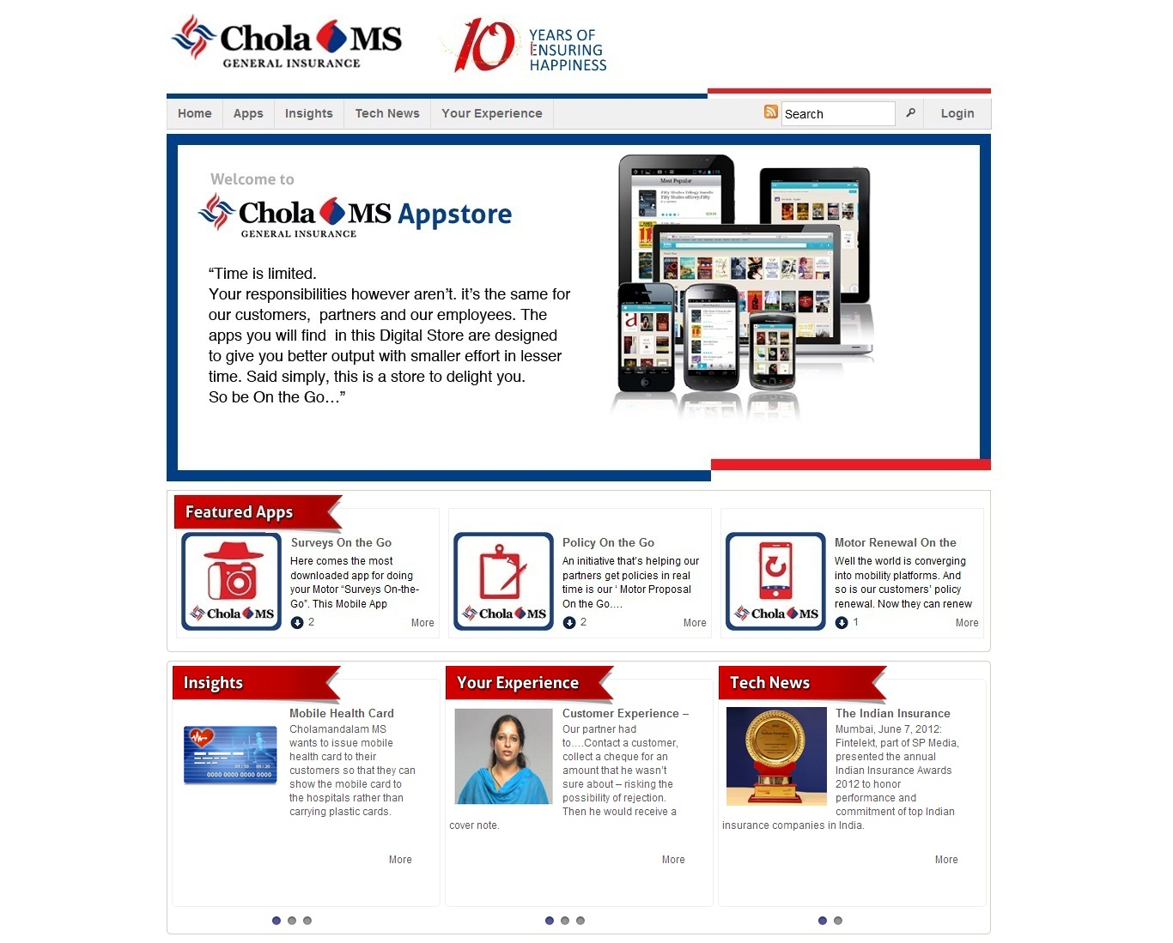
Chola-MS App Store
Implementation of Mastek’ s App Store Offering
Intuitive upload /versioning
Role Based Access Control- Each App, Post mapped to user category
Active Directory /Enterprise LDAP integration
App versioning & forced upgrade of app on version change
Statistics of number of downloads and usage reports
Comments and Social Media Integration and Features
Technology
Word Press Platform
Mobile Technologies
Android
iOS
J2ME
Blackberry
http://eezeeapps.cholainsurance.com/chola/

Slide 7
App Development Services
Mastek’ s mobile App Dev Services and App Store Offering helps our clients implement robust design, development, testing and roll-out to create state of the art applications and app stores
Enterprise Objectives
Delivery across multiple platforms/devices
Best user experience with code re-usability across platforms
Application robustness and middleware
Distributed transaction management
Mobile apps security audit
Agile model
Platforms
Android
Cross-Platform Tools
Phone Gap
Devices
HTML 5 Based
Blackberry
J2ME
Titanium Appcelerator
Tablets
Smartphones
Feature Phones
Mobile Web
iOS
Final Output / Deliverables
Key Mastek Value-adds
Stable applications
Robust , extensible and maintainable code base
High user experience and reusability
Cross-platform development using a combination of HTML-5 and Native code
App Store creation using Mastek App Store Offering based on Word Press
Mobility specific Testing and Application Security
Enterprise Architecture Integration
Domain knowledge (Financial services , Wealth Management)

Slide 8
Thank You

